Slide 1
The History of Personal Computing (Microsoft)
Prepared by
CHEREDNICHENKO BORIS
Student
Group TR31

Slide 2
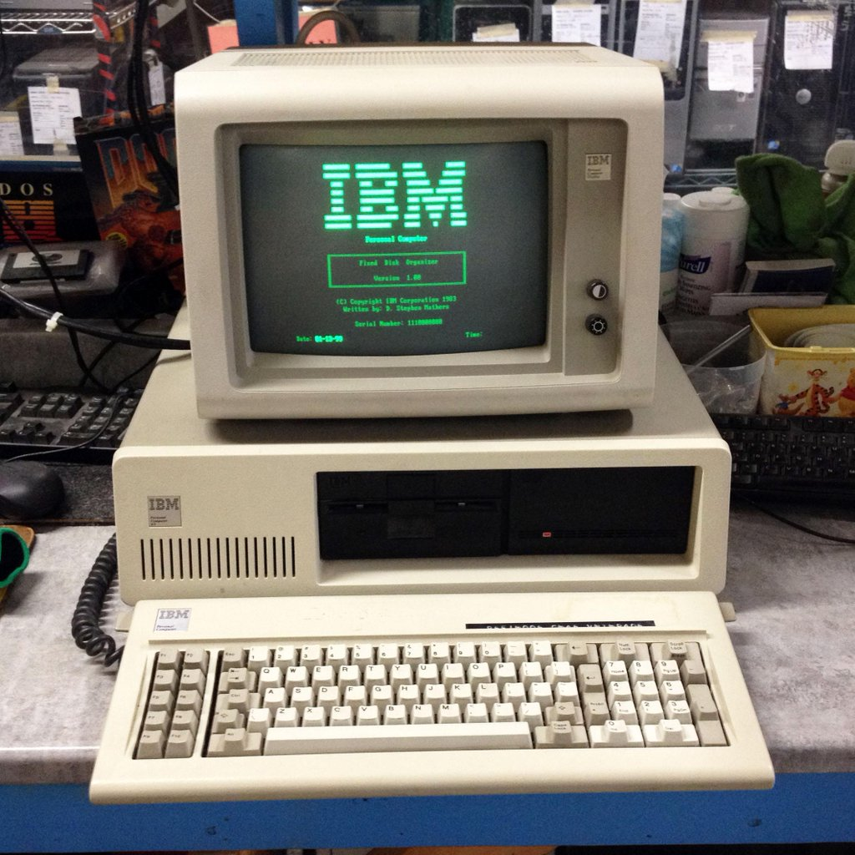
IBM PC 4.77 MHz Intel 8088 CPU

Slide 3

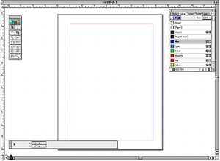
Adobe PageMaker

Slide 4
Adobe PageMaker
PageMaker was one of the first desktop publishing programs, introduced in 1985 by Aldus, initially for the Apple Macintosh and, in 1987, for PCs running Windows 1.0. As an application relying on a graphical user interface, PageMaker helped to popularize the Macintosh platform and the Windows environment.
PageMaker relies on Adobe Systems' PostScript page description language.
In 1994, Adobe Systems acquired Aldus and PageMaker.

Slide 5
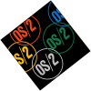
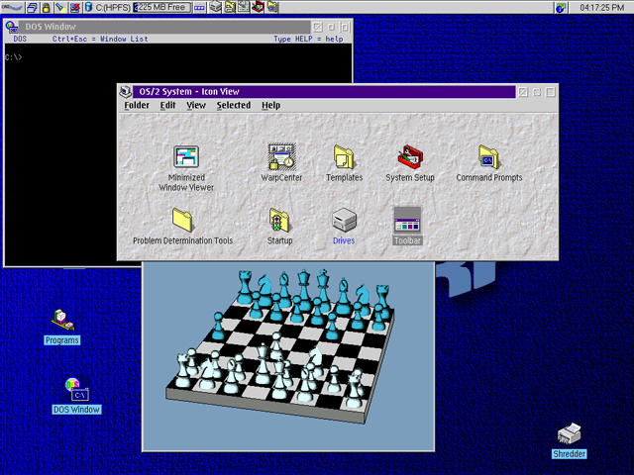
OS/2

Slide 6
OS/2
OS/2 is a series of computer operating systems, initially created by Microsoft and IBM, then later developed by IBM exclusively. The name stands for "Operating System/2", because it was introduced as part of the same generation change release as IBM's "Personal System/2 (PS/2)" line of second-generation personal computers. The first version of OS/2 was released in December 1987 and newer versions were released until December 2001.

Slide 7
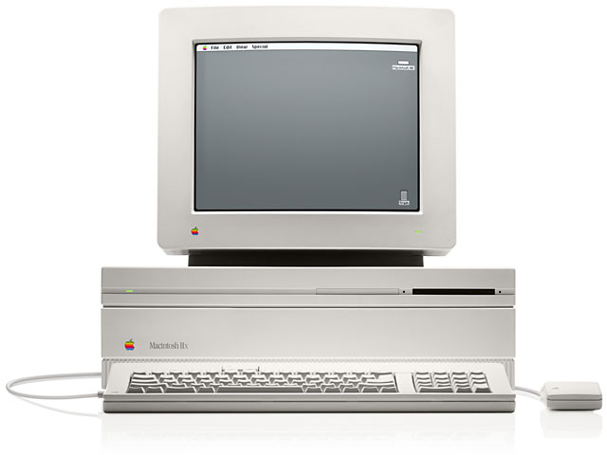
MAC II

Slide 8
MAC II
The Apple Macintosh II is the first personal computer model of the Macintosh II series in the Apple Macintosh line and the first Macintosh to support a color display. A basic system with 20 MB drive and monitor cost about $5500.

Slide 9

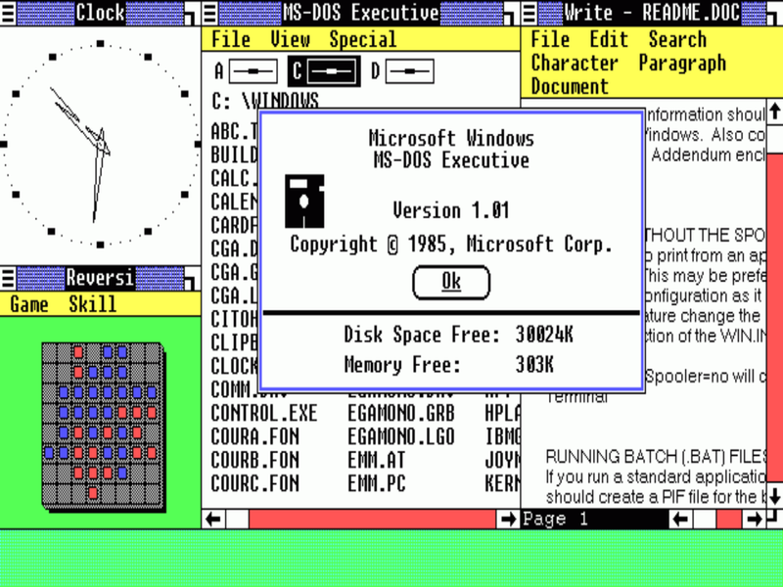
Windows 1.0

Slide 10
Windows 1.0
Windows 1.0 is a graphical personal computer operating environment developed by Microsoft. Microsoft had worked with Apple Computer to develop applications for Apple's January 1984 original Macintosh, the first mass-produced personal computer with a graphical user interface.

Slide 11
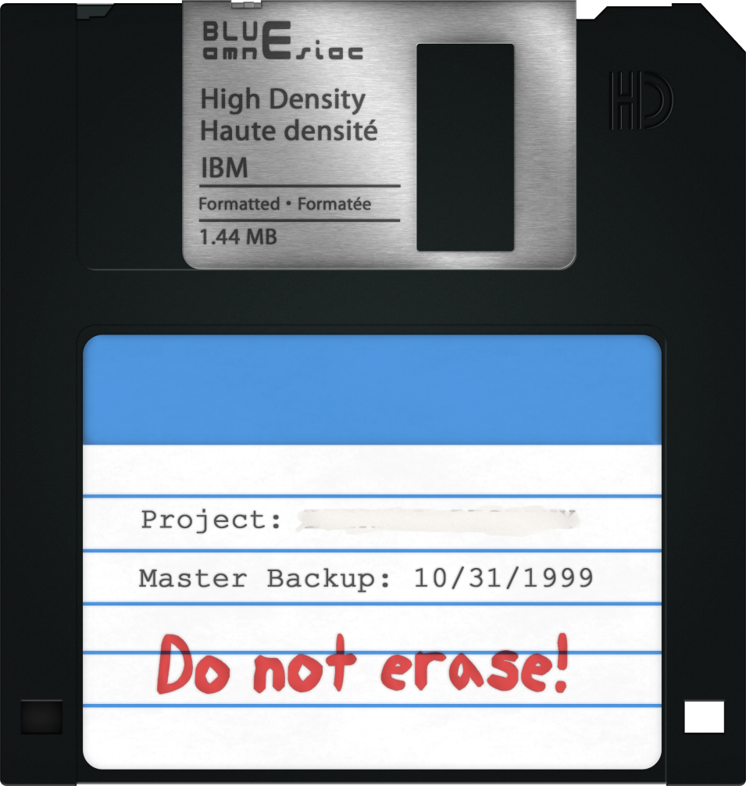
IBM formatted 3.5″ disk

Slide 12
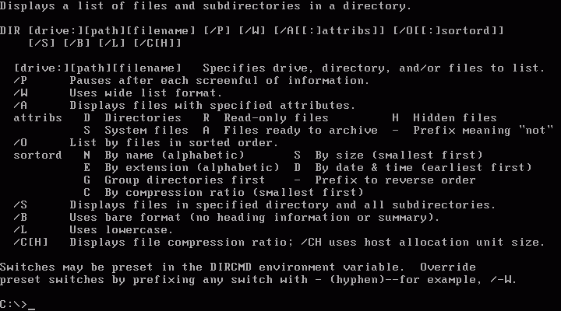
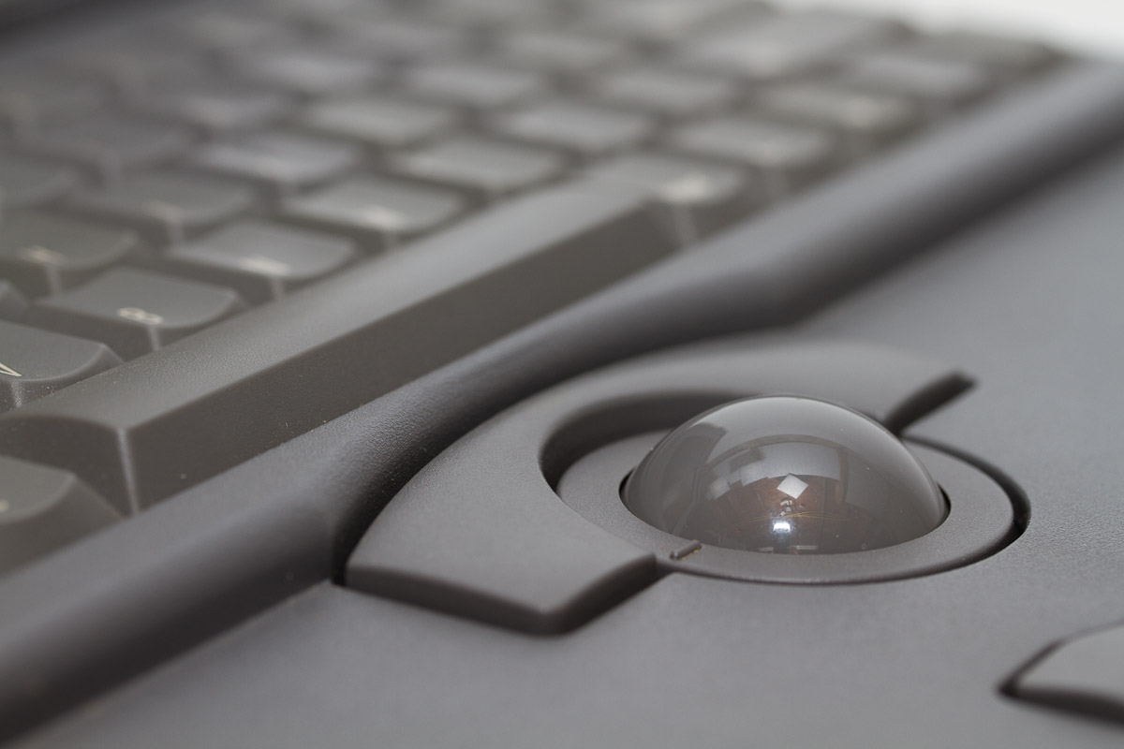
MS DOS
TRACKBALL

Slide 13
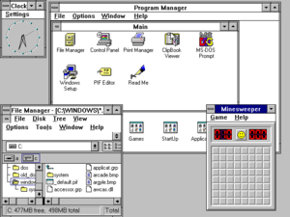
Windows 3.1

Slide 14
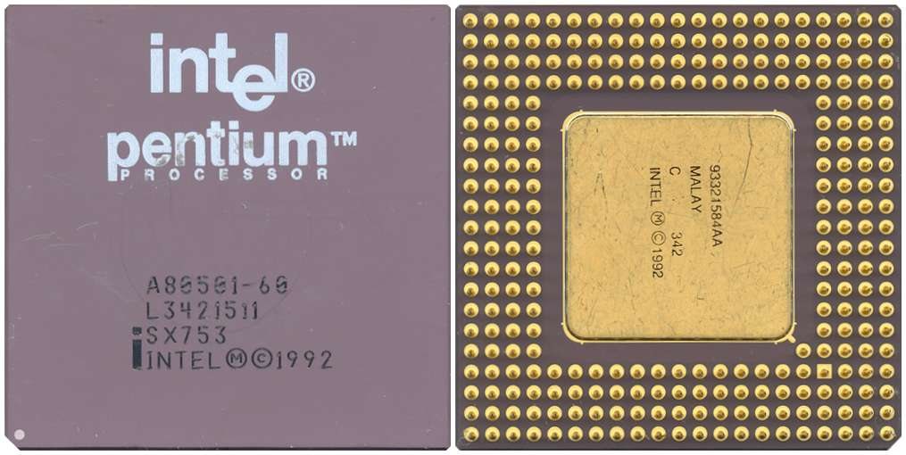
Pentium, a 60 MHz CPU

Slide 15
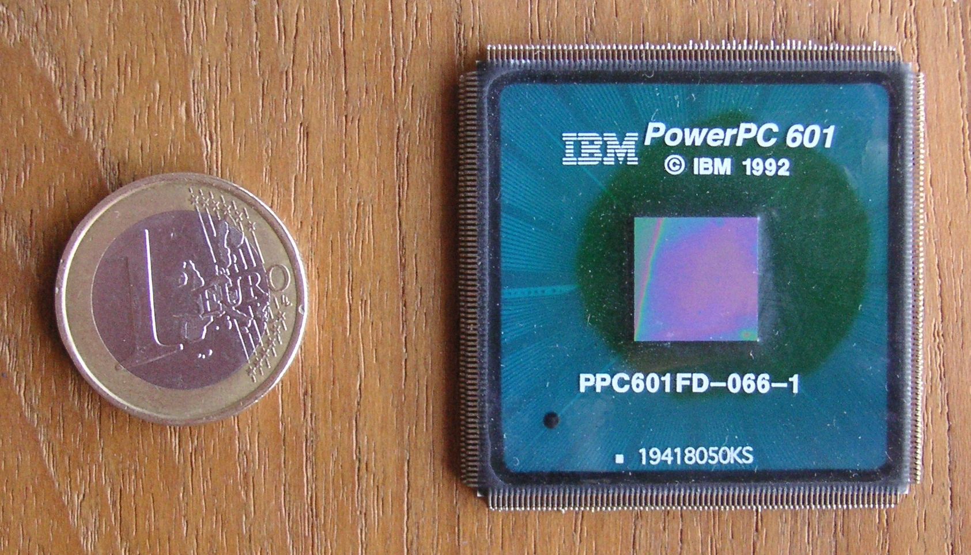
PowerPC 601 CPU

Slide 16
Thank you for the attention

